Slide 1

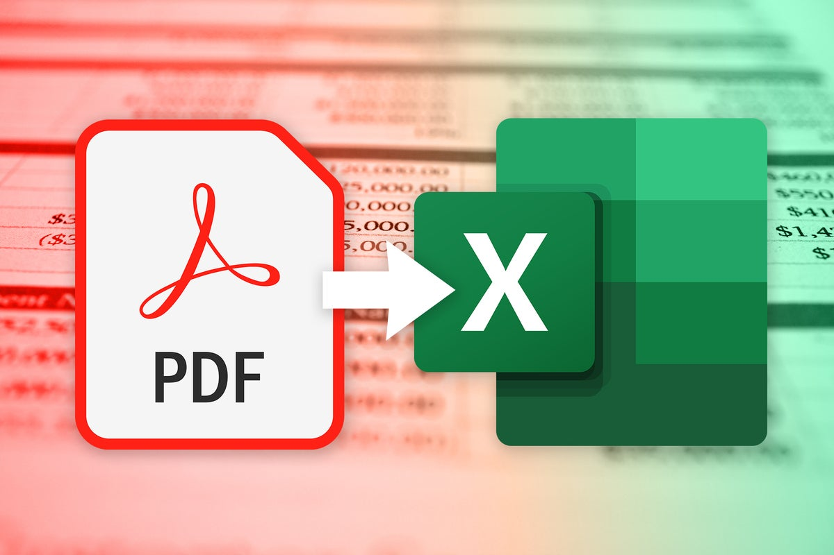
Monthly Report scraping/extraction program
Jazz Ooi
Notes:
data extraction = 提取資料
program = 程式

Slide 2
automation - Why?
Saves time
Extracting data from 900+ files takes 7-9 minutes
each file ~0.5s, compared to at least 10 seconds for human operation (opening file, inputting text etc.)
Human effort can be transferred to more important/less monotonous tasks
Reduce (but not eliminate) human error
Notes:
automate = 自動化
monotonous = 單調/平板
eliminate = 淘汰
human error = 人為錯誤

Slide 3



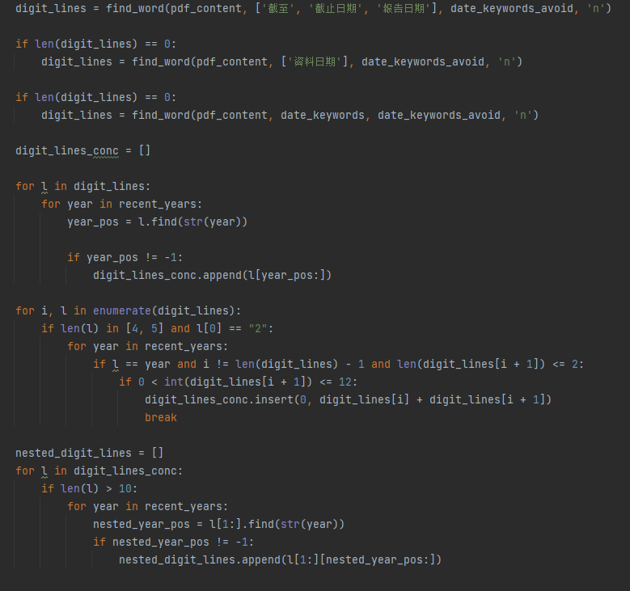
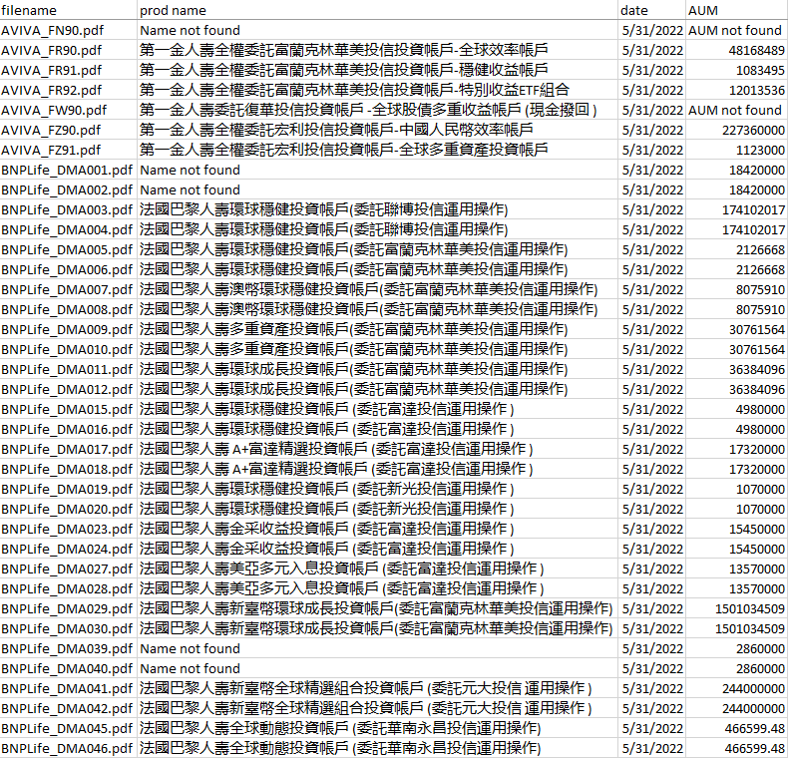
Monthly reports
(.pdf)
Data scraping program
(.py)
Output data
(.csv)
Notes:
structure = 結構
monthly report = 月報

Slide 4
Data extracted
File name (檔案名稱)
Date of data gathering (檔案日期)
AUM index (資產規模/帳戶規模)
Name of product (產品名稱)
utf-16 encoding as opposed to utf-8 used due to presence of both English and Chinese characters
Notes:
同時存在
characters = 字符

Slide 5
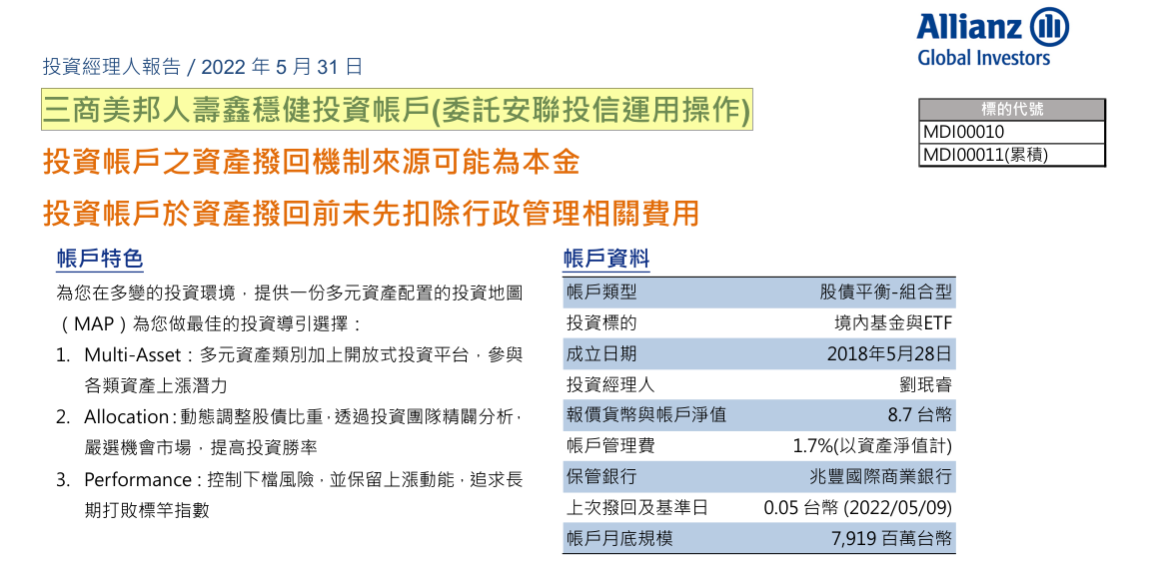
File name
Date of data gathering
AUM index
Name of product
1
3
2

Slide 6
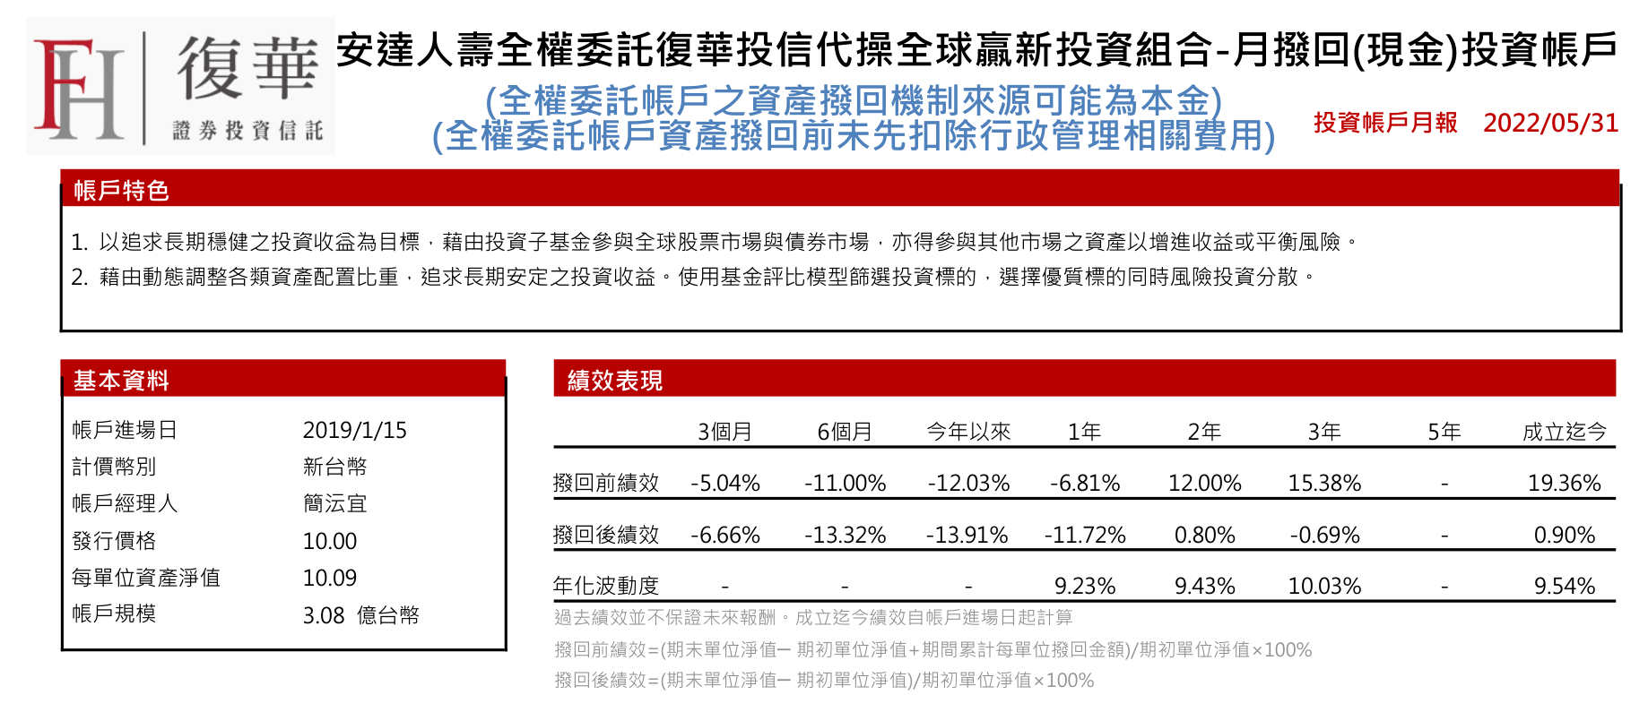
File name
Date of data gathering
AUM index
Name of product
4
2
3

Slide 7
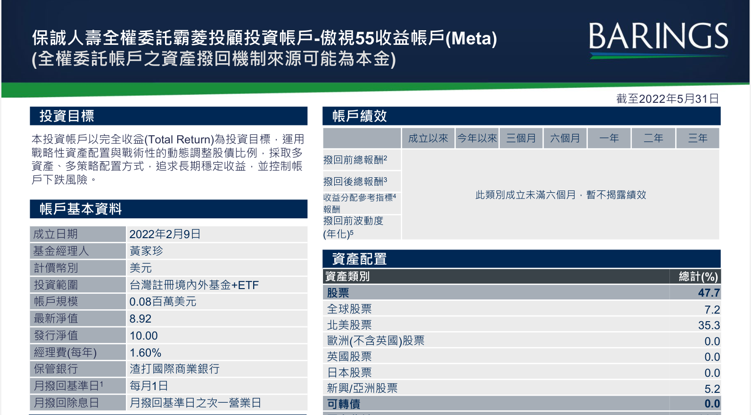
File name
Date of data gathering
AUM index
Name of product
4
2
3

Slide 8
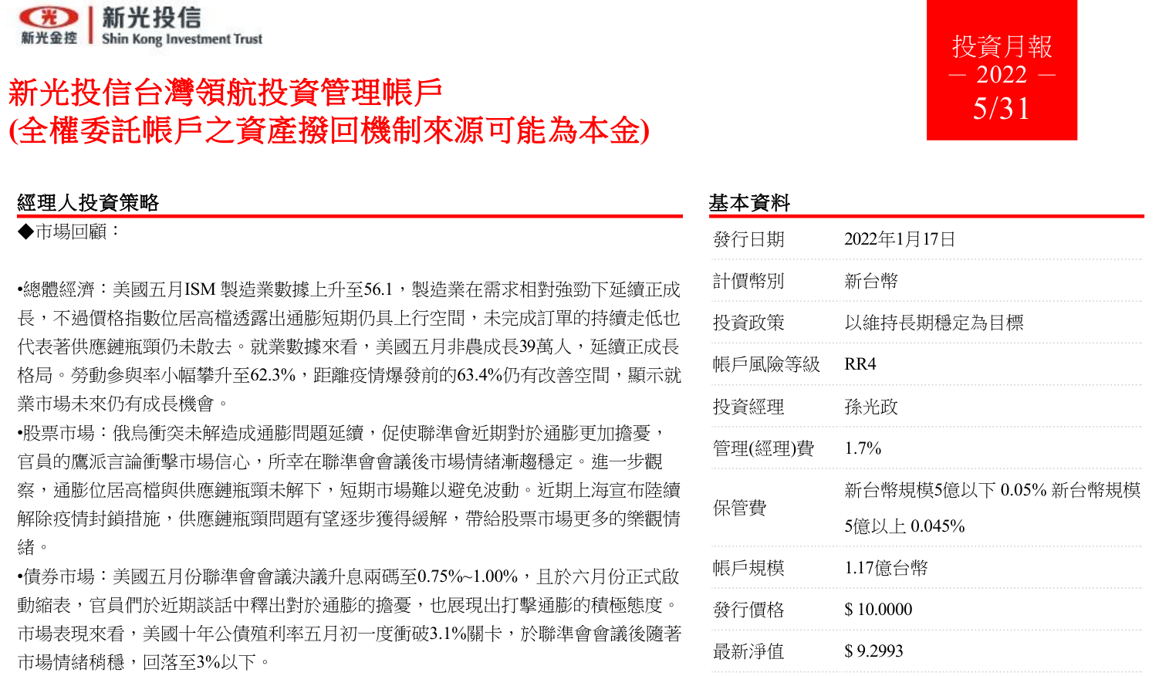
File name
Date of data gathering
AUM index
Name of product
4
2
3

Slide 9
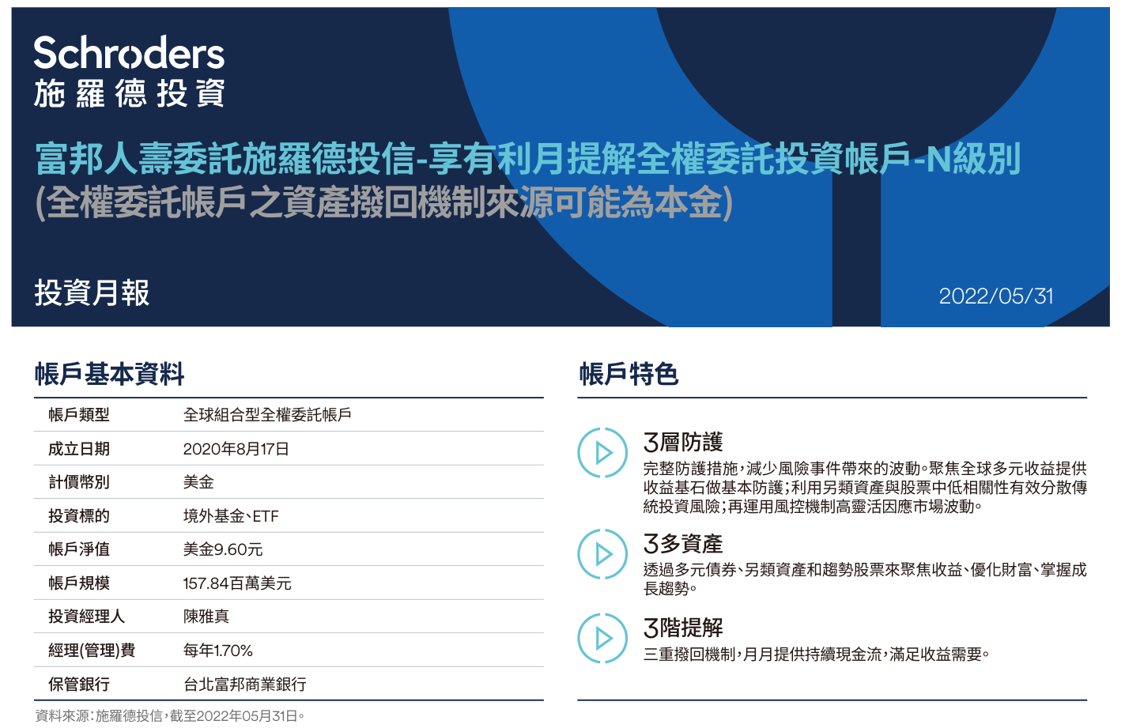
File name
Date of data gathering
AUM index
Name of product
4
2
3

Slide 10
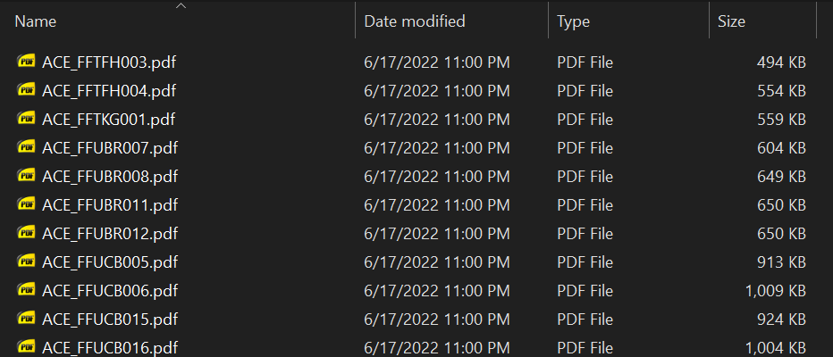
1. File name (檔案名稱)
File name can be taken directly from the file directory (檔案目錄)
….
SKL_K026_1.pdf
Allianz_NTDMD0030.pdf
Note:
File version
N/A indicates first version
_1 indicates second edition/first revision
_2 indicates third edition/ second revision
Etc.
(Most recent revision should always be prioritized)
Company name/code (壽險公司代碼)
Product code (商品代碼)
File
version/edition
File extension
Company name/code (壽險公司代碼)
Product code (商品代碼)
File extension
Notes:
file directory =檔案目錄
file edition = 檔案修改版本
file extension = 副檔名
most recent = 最近/新

Slide 11
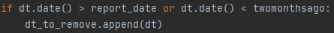
2. Date of data gathering (檔案日期)
general date (year and month) can be obtained from folder name
report_date
e.g. May 5月
last day of two months before report folder month
(31/3/2022)
≈ [twomonthsago]
first day of report folder month
(1/5/2022)
last day of report folder month
(31/5/2022)
[report_date]
past
|
|
|
future
filter out/remove
filter out/remove
possible date range
Notes:
folder = 文件夾

Slide 12

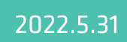
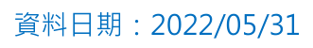
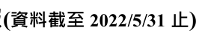
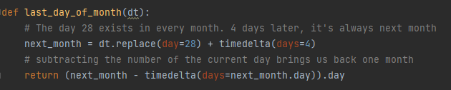
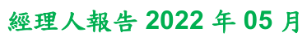




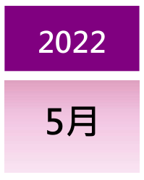
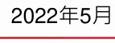
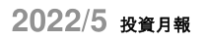
2. Date of data gathering (檔案日期)
Year and month always given
Day may not be given
In that case, take last day of the month
includes day
(31/5)
doesn’t
include day
(5)

Slide 13
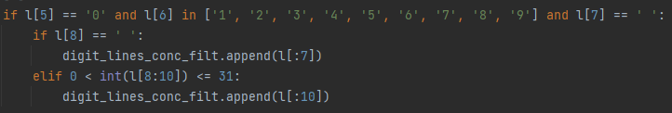
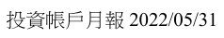
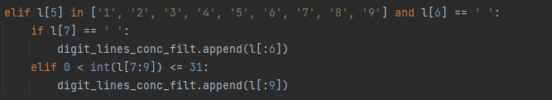

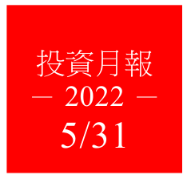
2. Date of data gathering (檔案日期)
Single digit months/days can have 0 preceding it
(2022/08/01 vs 2022/8/1)
05
5
Notes:
single/double digits = 個位數/兩位數
pad with zeros =

Slide 14
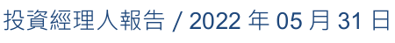

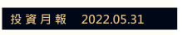
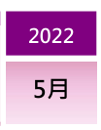
2. Date of data gathering (檔案日期)
Separators (分隔符號) can be: whitespace, “-”, “.”, “/”, “年月日”
only numeric character are extracted after date identified in certain line
YYYY年MM月DD日
YYYY.MM.DD
YYYY/MM/DD
whitespace/line breaks/
other formatting

Slide 15
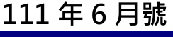
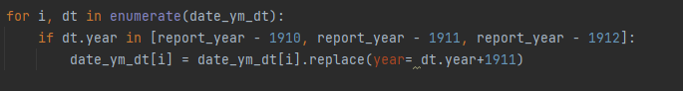
2. Date of data gathering (檔案日期)
Minguo calendar (民國紀年) may be used instead of Gregorian calendar (西元紀年)
if the former is used, difference (1911 years) is added
Minguo calendar
(民國紀年)
Gregorian calendar
(西元紀年)

Slide 16
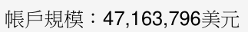
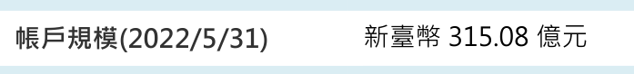
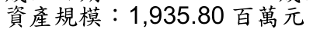
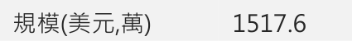
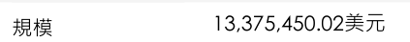
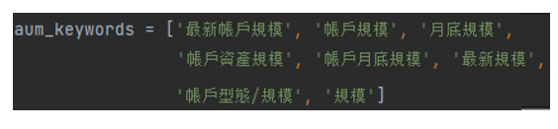
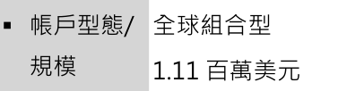
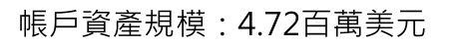
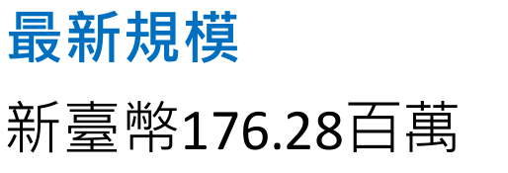
3. AUM index (資產規模/帳戶規模)
report might slightly different wording (不同措辭)
a variety of keywords (關鍵詞) are included
Notes:
keywords = 關鍵詞

Slide 17
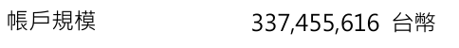
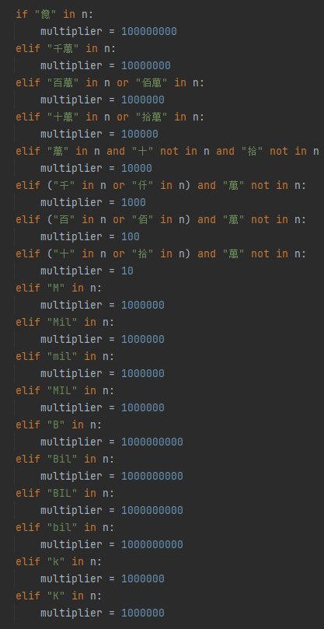
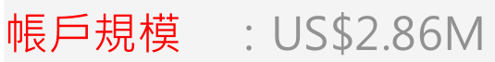
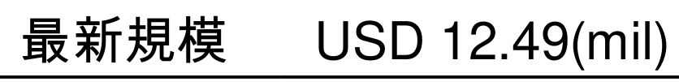
3. AUM index (資產規模/帳戶規模)
number prefix/suffix
multiplier with keywords used
no prefix/suffix
Chinese prefix
數目字
English prefix

Slide 18
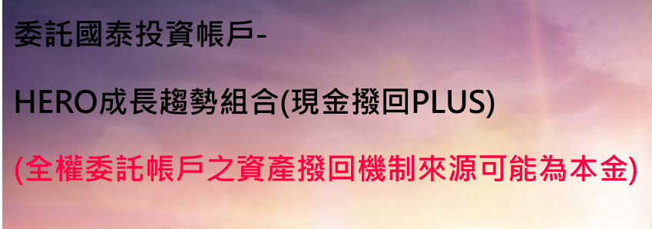
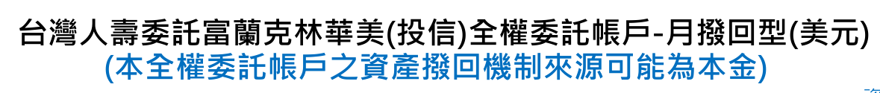

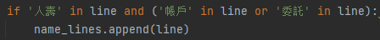
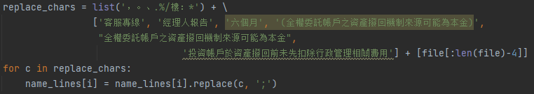
3. product name (產品名稱)
Keywords 人壽，賬戶 and 委托 are used to identify lines containing product name;
Certain keywords are filtered out to ensure the line isn’t incorrectly extracted
Due to variety of naming syntax/structure (line breaks, usage of parentheses) and differing wording, only ~65% accuracy achieved

Slide 19
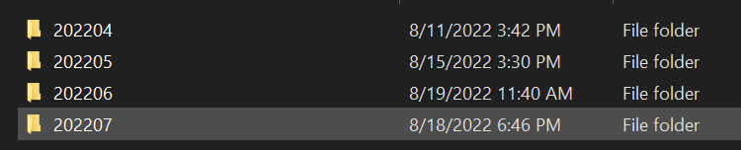
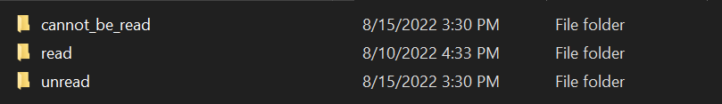
directory arrangement
In each folder (month and year), there are 3 folders;
Reports to be read should be placed in the “unread” folder
After extracting data, reports with data successfully extracted will be transferred to the “read” folder
Reports with data that cannot be successfully extracted/read will be transferred to the “cannot_be_read” folder, for manual reading and inputting of data
(無法讀取)
(已讀取)
(未讀取)
Notes:
cannot be extracted = 無法提取/抽取

Slide 20
Statistics
Test data: monthly reports from April, May of 2022 (202204, 202205):
Total tested: 945 files
Date extracted: 96.20% (909 files, 36 could not be extracted)
Date correct: 95.68% (905 files, 5 extracted but incorrect)
Accuracy of extracted files: 99.56%
AUM extracted: 80.21% (758 files, 187 could not be extracted)
AUM correct: 79.89% (755 files , 3 extracted but incorrect)
Accuracy of extracted files: 99.60%
product name extracted: 83.49% (789 files, 156 could not be extracted)
product name correct: 64.97% (614 files , 331 extracted but incorrect)
Accuracy of extracted files: 77.82%

Slide 21
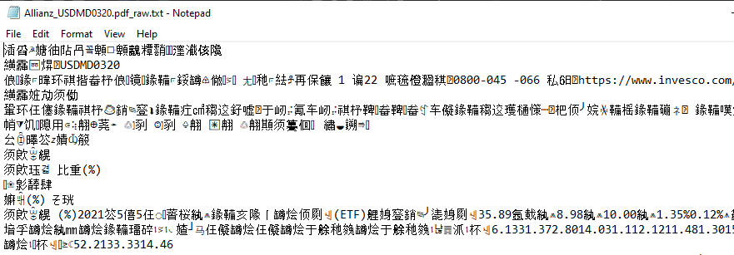
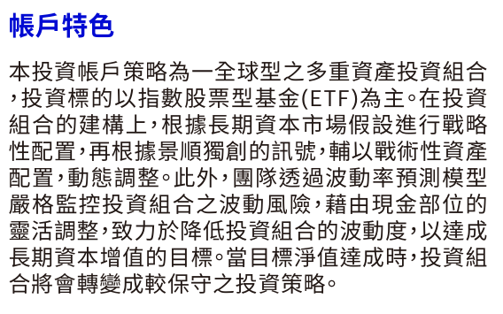
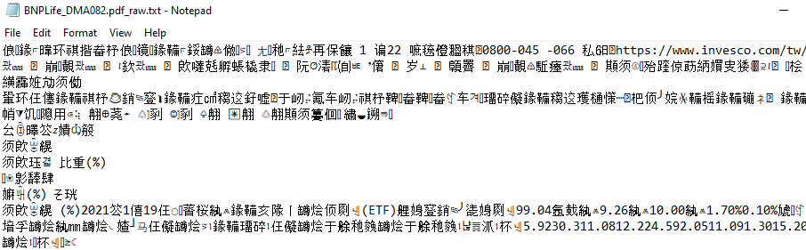
limitations – file read corruption
File corruption
Unicode encoding conflict
Font error
Correct text is cannot be scraped
manual
copy/pasting
����������������
�������������(ETF)���������������������������
��������������������������������������������
���������������������
�������������
Notes:
font = 字體

Slide 22
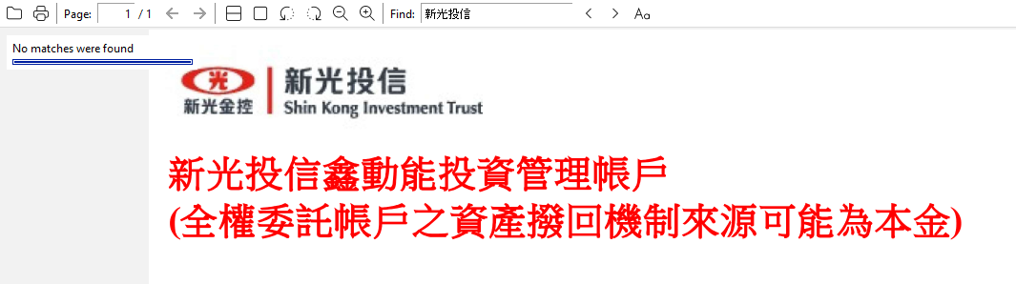




limitations – images
pdf file is an image, no text
Correct text cannot be extracted
pdf is a series
of images
(since text is saved as pixels, low definition)
(empty)
pdf is readable
text
(since text is saved as Unicode characters, higher definition)

Slide 23




limitations – Why not ocr?
Tesseract OCR (Optical Character Recognition, 光學字元辨識) was attempted, but:
accuracy was low, especially with:
Chinese characters
punctuation
different languages in the same document
different fonts in the same document
low resolution (certain pdfs)
Whitespaces, tabs and line breaks often incorrectly recognized
e.g. 2022 12 1 vs 2022 1 21 vs 2022121
Graph and table formatting is not recognized
runtime and memory usage increased drastically due to external importing and processing (+20-30%)
only a few files are images and need OCR for text recognition (10 files out of 945; or 1.06%)

Slide 24
謝謝！
Thank you!

